Slide 1
anemia management in the elderly ckd patients
Prof. Ali Taha Alkoriaty
Professor of internal medicine and nephrology
Head of internal medicine department
S0hag faculty of medicine

Slide 2
Historical background
Richard Bright (1836): first observed that anemia was a complication of renal failure.
Robert Christison: further described renal anemia.
Miyake (1977): purified and identified Epo.
Eschbach (Dec 2, 1985): first human use of EPO

Slide 3
Effect of 1 g/dL fall in Hb
1.6
1.55
1.49
1.4
1.24
1.25
1.2
1.0
1
1
Relative risk
0.8
0.6
0.4
0.2
0
CLVH
LV Dil
SDF
CCF
IHD
Death
CLVH = concentric left ventricular hypertrophy
LV Dil = left ventricular dilatation
SDF = systolic dysfunction
CCF = chronic cardiac failure
IHD = ischaemic heart disease
Foley et al Am J Kidney Dis 2014; 28: 53-61 .

Slide 4
Other effects of anemia in ckd
Acceleration of progression of kidney disease by oxygen deprivation.
Increased risk of bacteremia (11% increased risk for every 1g/dl fall in Hb)
Detrimental effects on brain and cognitive functions.

Slide 5
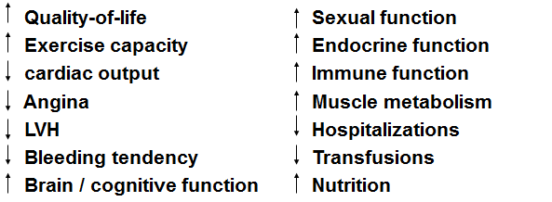
Benefits of anemia Control

Slide 6
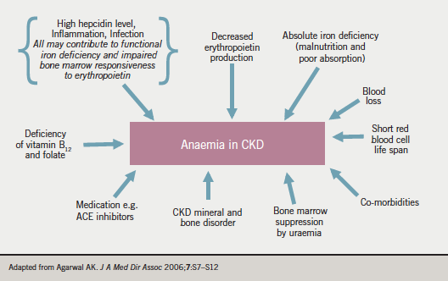

Slide 7
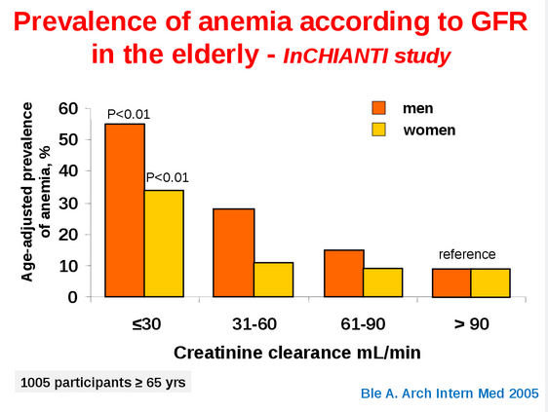

Slide 8
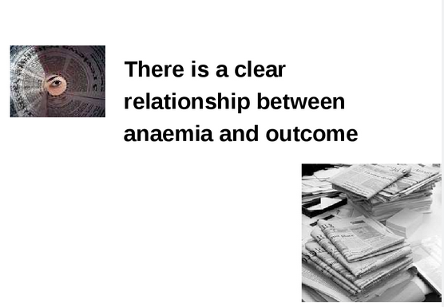

Slide 9
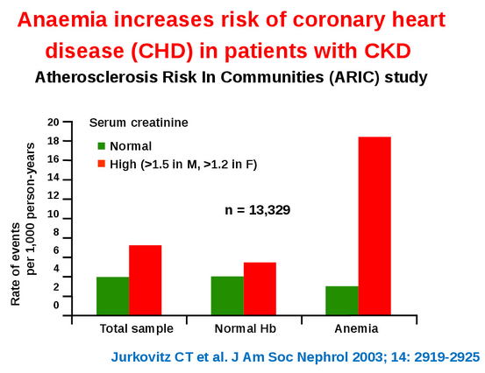

Slide 10
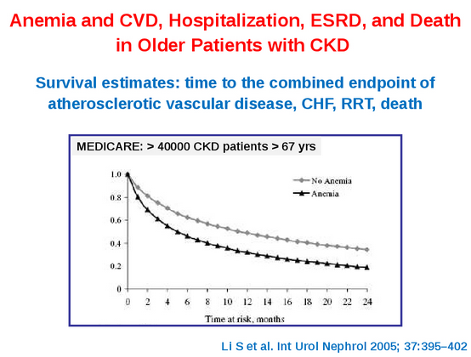

Slide 11
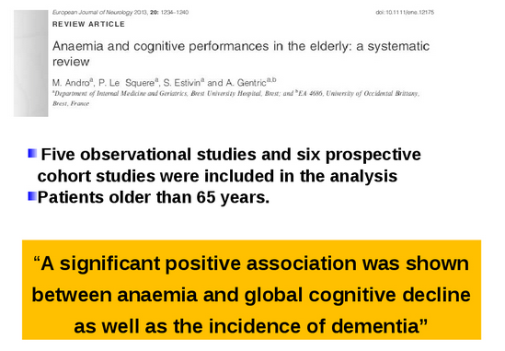

Slide 12
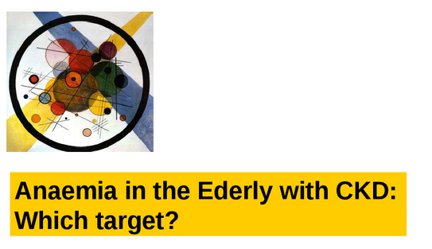

Slide 13
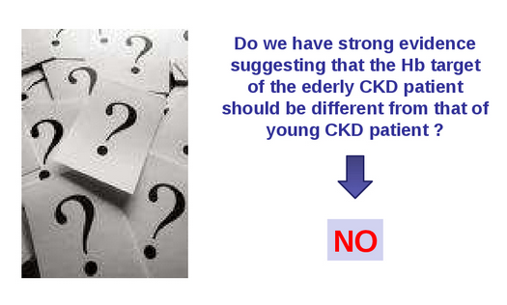

Slide 14
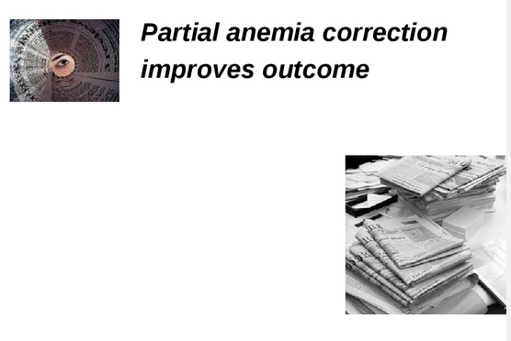

Slide 15
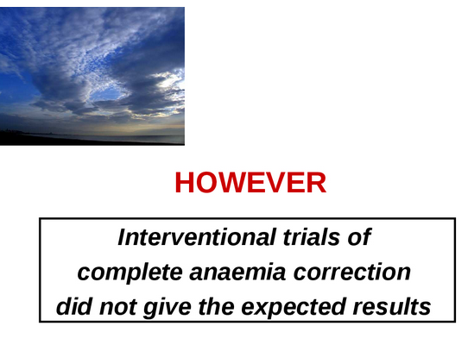

Slide 16
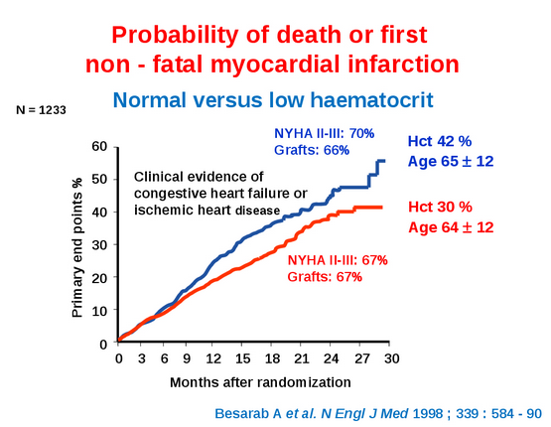

Slide 17
CREATE: In patients with CKD early and complete correction of anaemia did not reduce the risk of CV events
Primary endpoint: Time to first CV event
Hazard ratio: 0.78; 95% CI, 0.53–1.14; p=0.20)
600
High Hb: 13.0-15 g/dL
Standard Hb: 10.5-11.5 g/dL
16
16
1.0
1.0
14
0.8
12
0.6
Haemoglobin (g/dL)
Survival
10
0.4
0.2
8
0
0
0
6
12
18
24
30
36
42
48
0
6
12
18
24
36
36
42
48
Months
Months
58 events (high Hb, n=301) vs 47 events (low Hb, n=302)
CREATE, Cardiovascular Risk Reduction by Early Anemia Treatment with Epoetin Beta
Drüeke TB et al N Engl J Med 2006;355:2071–2084
Copyright © [2006] Massachusetts Medical Society. All rights reserved.
Notes:
17
Key points:
During the 3-year study, complete correction of anemia did not affect the likelihood of a first cardiovascular event.
Left ventricular mass index remained stable.
In patients with chronic kidney disease, early complete correction of anemia does not reduce the risk of cardiovascular events.
Limitations CREATE:
Start dialysis not standardized
Annual event rate much lower that expected
Abstract:
BACKGROUND: Whether correction of anemia in patients with stage 3 or 4 chronic kidney disease improves cardiovascular outcomes is not established.
METHODS: We randomly assigned 603 patients with an estimated glomerular filtration rate (GFR) of 15.0 to 35.0 ml per minute per 1.73 m2 of body-surface area and mild-to-moderate anemia (hemoglobin level, 11.0 to 12.5 g per deciliter) to a target hemoglobin value in the normal range (13.0 to 15.0 g per deciliter, group 1) or the subnormal range (10.5 to 11.5 g per deciliter, group 2). Subcutaneous erythropoietin (epoetin beta) was initiated at randomization (group 1) or only after the hemoglobin level fell below 10.5 g per deciliter (group 2). The primary end point was a composite of eight cardiovascular events; secondary end points included left ventricular mass index, quality-of-life scores, and the progression of chronic kidney disease.
RESULTS: During the 3-year study, complete correction of anemia did not affect the likelihood of a first cardiovascular event (58 events in group 1 vs. 47 events in group 2; hazard ratio, 0.78; 95% confidence interval, 0.53 to 1.14; P=0.20). Left ventricular mass index remained stable in both groups. The mean estimated GFR was 24.9 ml per minute in group 1 and 24.2 ml per minute in group 2 at baseline and decreased by 3.6 and 3.1 ml per minute per year, respectively (P=0.40). Dialysis was required in more patients in group 1 than in group 2 (127 vs. 111, P=0.03). General health and physical function improved significantly (P=0.003 and P<0.001, respectively, in group 1, as compared with group 2). There was no significant difference in the combined incidence of adverse events between the two groups, but hypertensive episodes and headaches were more prevalent in group 1.
CONCLUSIONS: In patients with chronic kidney disease, early complete correction of anemia does not reduce the risk of cardiovascular events.
17

Slide 18
CHOIR: The use of a high target Hb level was associated with increased cardiovascular risk
Primary endpoint: Time to death or CV event
Hazard ratio: 1.34; 95% CI, 1.03–1.74; p=0.03
High Hb: 13.5 g/dL
Standard Hb: 11.3 g/dL
1400
15.0
0.30
14.0
0.25
13.0
0.20
12.0
Mean haemoglobin (g/dL)
Probability of composite event
0.15
11.0
0.10
10.0
0.05
0
0.00
0
4
8
12
16
20
24
28
32
36
0
3
6
9
12
15
18
21
24
27
30
33
36
39
Months
Months
125 events (high Hb, n=715) versus 97 events (low Hb, n=717)
CHOIR, Correction of Hemogloblin and Outcomes in Renal Insufficiency
Singh AK et al N Engl J Med 2006;355:2085–2098
Notes:
18
Key points:
The use of a target hemoglobin level of 13.5 g per deciliter (as compared with 11.3 g per deciliter) was associated with increased risk and no incremental improvement in the quality of life.
A total of 222 composite events occurred: 125 events in the high-hemoglobin group, as compared with 97 events in the low-hemoglobin group :
65 deaths (29.3%)
101 hospitalizations for congestive heart failure (45.5%)
25 myocardial infarctions (11.3%)
23 strokes (10.4%).
Limitations CHOIR:
Higher prevalence of coronary artery by-pass and hypertension in the high hemoglobin group
Majority of randomized patients prematurely lost before study end
Target Hb not achieved despite high epoetin doses
Prematurely stopped because of suggestion of harm, without considering usual stopping rule
Abstract:
BACKGROUND: Anemia, a common complication of chronic kidney disease, usually develops as a consequence of erythropoietin deficiency. Recombinant human erythropoietin (epoetin alfa) is indicated for the correction of anemia associated with this condition. However, the optimal level of hemoglobin correction is not defined.
METHODS: In this open-label trial, we studied 1432 patients with chronic kidney disease, 715 of whom were randomly assigned to receive a dose of epoetin alfa targeted to achieve a hemoglobin level of 13.5 g per deciliter and 717 of whom were assigned to receive a dose targeted to achieve a level of 11.3 g per deciliter. The median study duration was 16 months. The primary end point was a composite of death, myocardial infarction, hospitalization for congestive heart failure (without renal replacement therapy), and stroke.
RESULTS: A total of 222 composite events occurred: 125 events in the high-hemoglobin group, as compared with 97 events in the low-hemoglobin group (hazard ratio, 1.34; 95% confidence interval, 1.03 to 1.74; P=0.03). There were 65 deaths (29.3%), 101 hospitalizations for congestive heart failure (45.5%), 25 myocardial infarctions (11.3%), and 23 strokes (10.4%). Seven patients (3.2%) were hospitalized for congestive heart failure and myocardial infarction combined, and one patient (0.5%) died after having a stroke. Improvements in the quality of life were similar in the two groups. More patients in the high-hemoglobin group had at least one serious adverse event.
CONCLUSIONS: The use of a target hemoglobin level of 13.5 g per deciliter (as compared with 11.3 g per deciliter) was associated with increased risk and no incremental improvement in the quality of life.
18

Slide 19
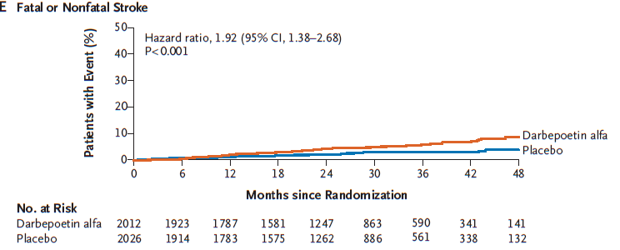
The TREAT study
Pfeffer et al, NEJM, 2010
TREAT :increase strokes in higher hb gp (achieved 10.5 vs 12.5)

Slide 20
More time spent <11 g/dL was associated with increased risk of hospitalization and mortality
Death
n = 54’328 dialysis patients
Hospitalization
*p < 0.0001
3.0
2.48*
2.0
1.72*
1.79*
Odds ratio (95% CI)
1.47*
1.36*
1.33*
1.0
0.0
1
2
3
Time spent with Hb <11 g/dL (months)
CI, Confidence interval
Ishani A et al. Nephrol Dial Transplant 2008;23: 1682-1689
Notes:
20
20
Key points:
The final cohort included 54 328 patients who met criteria.
The longer time spent below target was associated with increased risk of hospitalization (RR 1.70, 95% CI 1.63-1.76) and mortality (RR 2.48, 95% CI 2.28-2.69).
Abstract:
BACKGROUND: A proportion of haemodialysis patients experience periods below target haemoglobin levels due to longer time required to reach the target or to haemoglobin level variability. We aimed to determine the consequences associated with cumulative number of months below target haemoglobin concentrations.
METHODS: We constructed an incident cohort including patients whose day 91 after dialysis initiation fell between 1 January and 31 December 2002. Haemoglobin concentration, erythropoiesis-stimulating agent dose, comorbid condition and hospitalization data were obtained from Medicare claims. Patients were classified by 0, 1, 2 or 3 months with haemoglobin concentration below the K/DOQI target (11 g/dL). Using an inverse probability weighted marginal structural model to adjust for time-varying factors associated with haemoglobin concentration, we determined the association between number of months below target and subsequent risk for hospitalization and mortality.
RESULTS: The final cohort included 54 328 patients who met criteria. Those with more months below haemoglobin target were less likely to have received intravenous iron. More months below target were associated with increased risk of hospitalization (RR 1.70, 95% CI 1.63-1.76) and mortality (RR 2.48, 95% CI 2.28-2.69).
CONCLUSIONS: Future interventions should focus on modifiable factors associated with greater time below target haemoglobin concentrations to determine whether altering the time below target can alter the risk of hospitalizations or mortality.

Slide 21
“in fact, clinical guidelines are supposed to be guides, not rules, and tailoring of therapy is a critical aspect of management because ‘one size certainly does not fit all patients’.

Slide 22
Summary, target
Targeting 10 (10.5)-12g/dl is safe in dx and pre dx patients
Targeting higher Hb is risky in older patients, diabetics, CVD and poor responders to ESA.
Risks of higher Hb only refer to TARGETING higher levels using ESA
Special considerations for healthier and younger as well as symptomatising patients

Slide 23
Managing Iron Needs

Slide 24
Diagnosing iron deficiency
Absolute deficiency
  TSat
    Flaws related to nutitional transferrin deficiency
  Ferritin
    Flaws related to inflammation
  Percentage microcytic cells
    Flaws related to cell swelling
  Reticulocyte Hb content

Slide 25
Diagnosing iron deficiency
Functional deficiency
  Pathophysiology
    Inflammation, hepcidin, transferrin deficiency
  Lab diagnosis
    High ferritin, low TSAT
  Clinical
    Therapeutic testing
Notes:
Even patients with replete bm and lab parameters in range, 30% would respond to xtra doses of iron

Slide 26
“Targets” of iron repletion
Ferritin > 200 (Hdx)/100 (NDD and PD), up to 500
TSat
  20-30

Slide 27
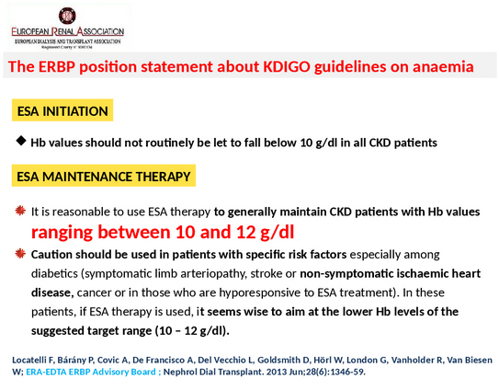

Slide 28
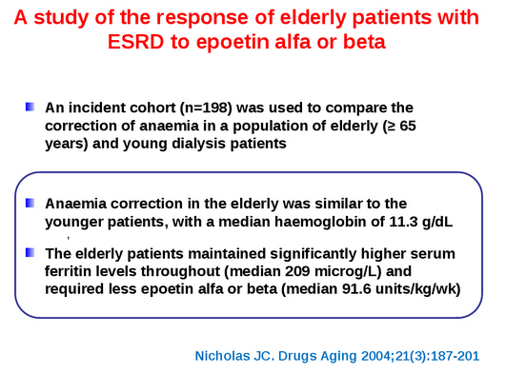

Slide 29
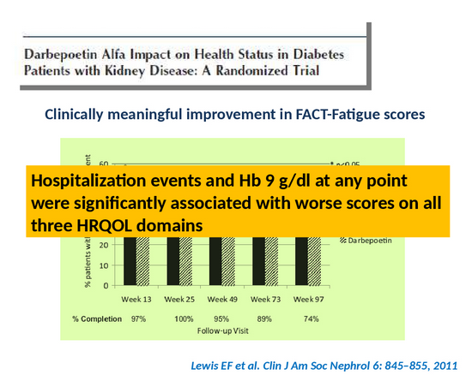

Slide 30
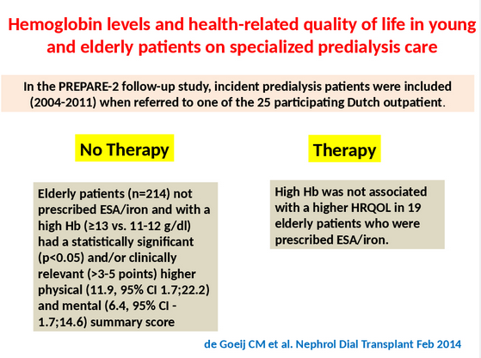

Slide 31
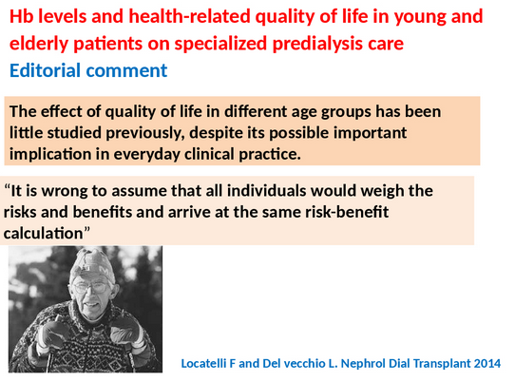

Slide 32
Adverse Effects of ESA Therapy
Worsening of HTN
Seizure
Increased blood clotting
Slight decrease of Kt/ V
Impaired phosphorus balance
Hyperkalemia
Expensive
Pure Red cell aplasia (PRCA)

Slide 33
Hyporesponsiveness to ESA
Inflammation (ferritin, CRP)
Iron deficiency
Under-dialyis
Blood loss
Malignancy, myeloma
Drugs
Hematological disease
?hyperparathyroidism
Nutritional
Aluminum

Slide 34
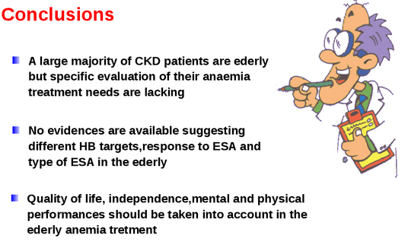

Slide 35
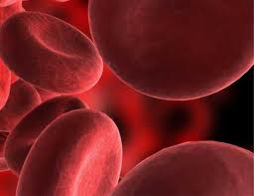
THANK YOU

